Slide 1

Real Estate Sales
Final Project- ENGR 1330
Instructor- Mr. Burks
Group 22
Aakash Bora and Om Muley

Slide 2
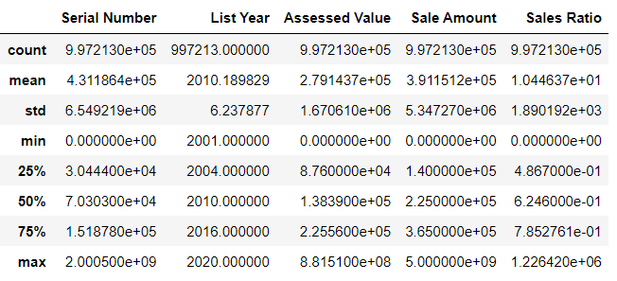
Data Set Description:

Slide 3
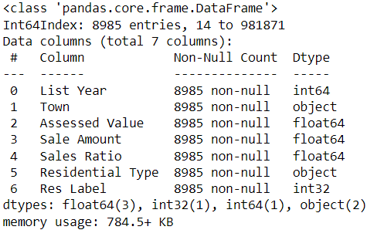
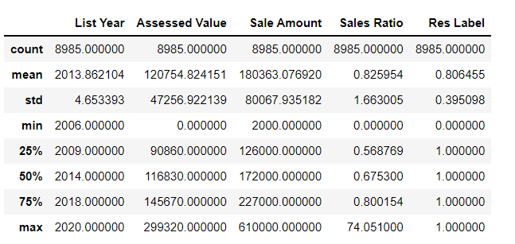
The Data Set we chose:
Firstly, we removed all the columns which were not relevant to our model.
We have selected just one town (Bristol) to make our data as consistent as possible.
Removed outliers such as for our prediction we only selected single family and condo for the residential type which is our y for this model.
We dropped all the NaN values from our data frame.
So, our final data frame has 8985 data entries and we have selected Bristol as our town.

Slide 4
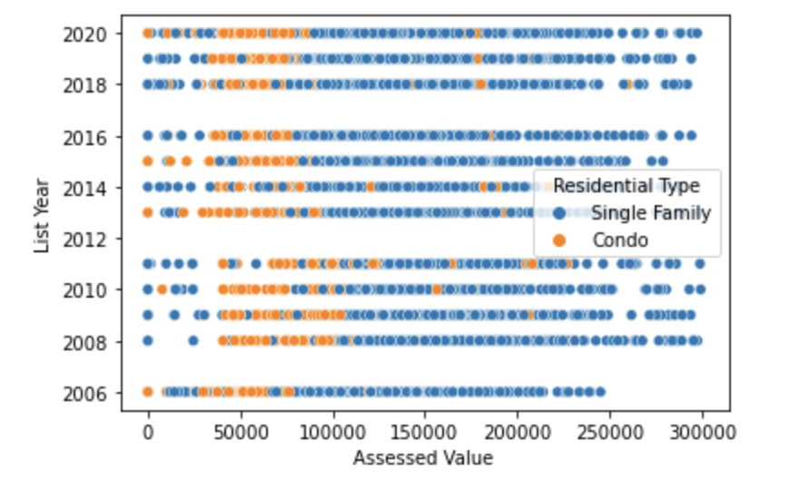
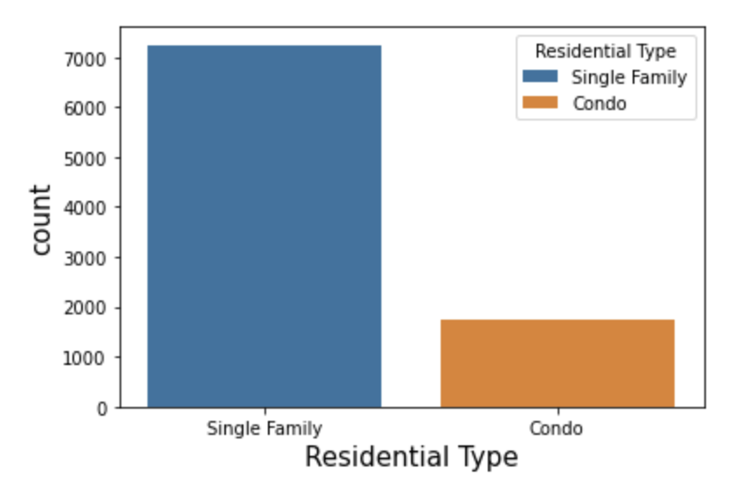
Graph of Data and Model
This is a graph of Assessed Value and the List year vs Residential Type of the original data
As you can see, there are some outliers at the left side of the graph.
This graph shows the count of Single Family and Condo in our data frame.
According to the data, almost 80% are single family and rest 20% are condo.

Slide 5
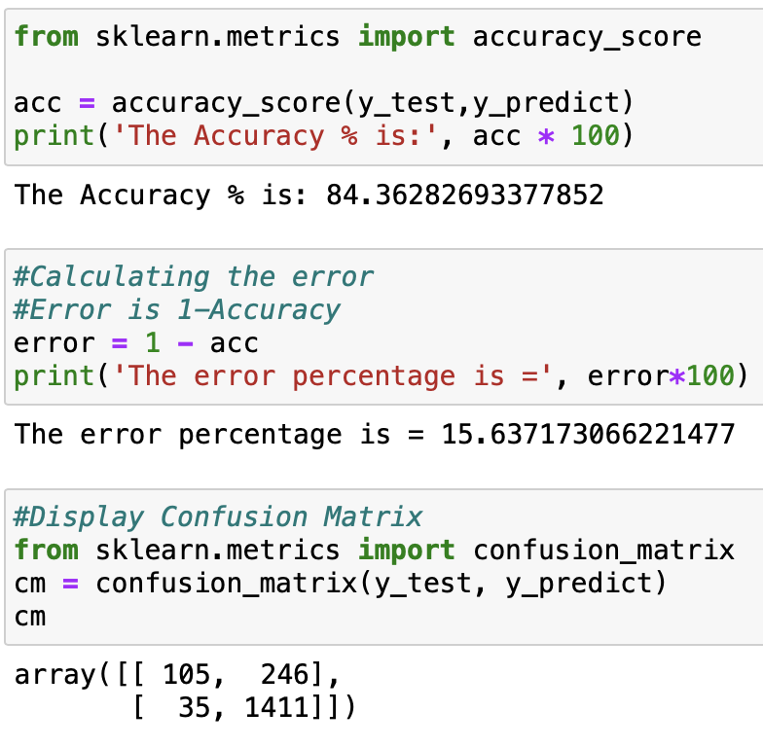
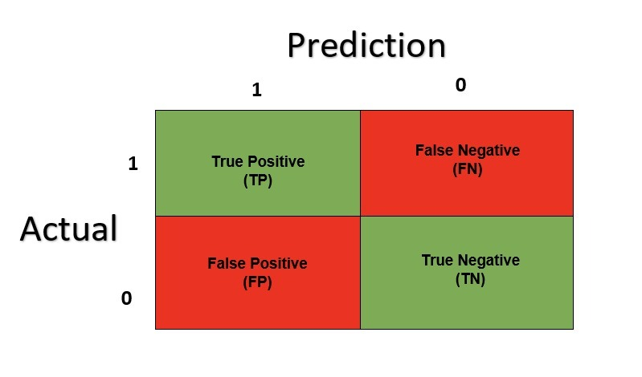
Accuracy, Error, and Confusion Matrix
As we are only predicting if the residential type is single family or condo, we have used binary classification.
The accuracy of our model varies from 84-89%.
The error for the model is between 11-16%.

Slide 6
Predictions
III
Independent Variables (x):
1) List Year
2) Assessed Value
We have used Logistic Regression for this model. Linear Regression is a type of classification. It is a model with an input variable(x) and an output variable(y), which has a discrete value of either 1 or 0.
Dependent Variables (y):
1) Residential Type
We are predicting the residential type(y) based on the assessed value and list year(X) which is our y and X value.
According to our understanding assessed value is the variable which plays the largest role in predicting the residential type.
As you can see by referring the graph, there's a clear correlation between assessed value and the residential type.

Slide 7
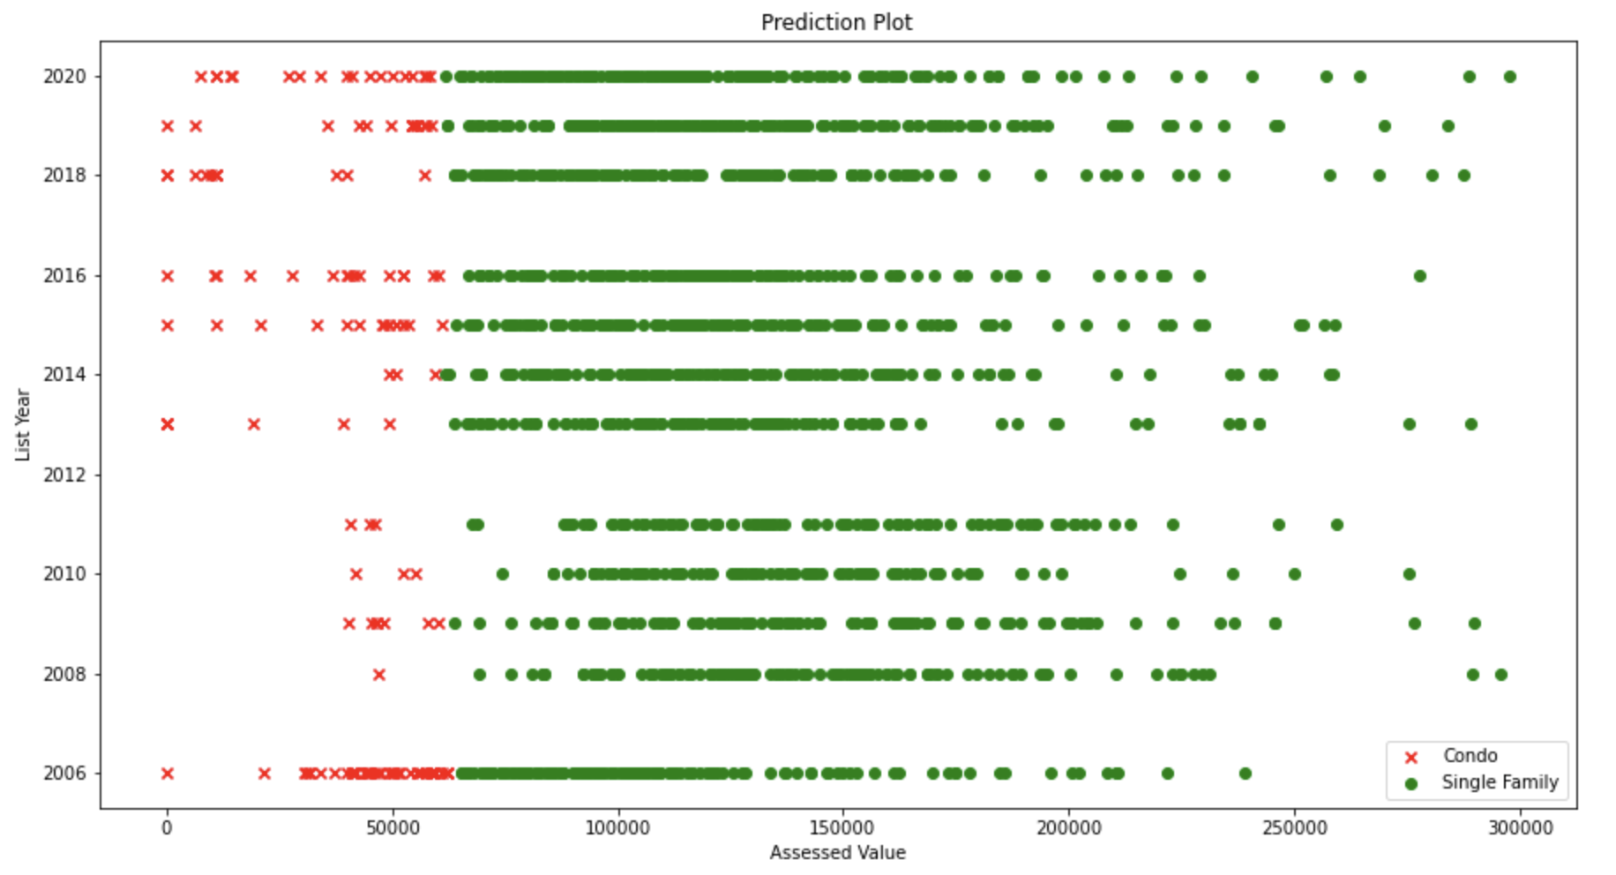
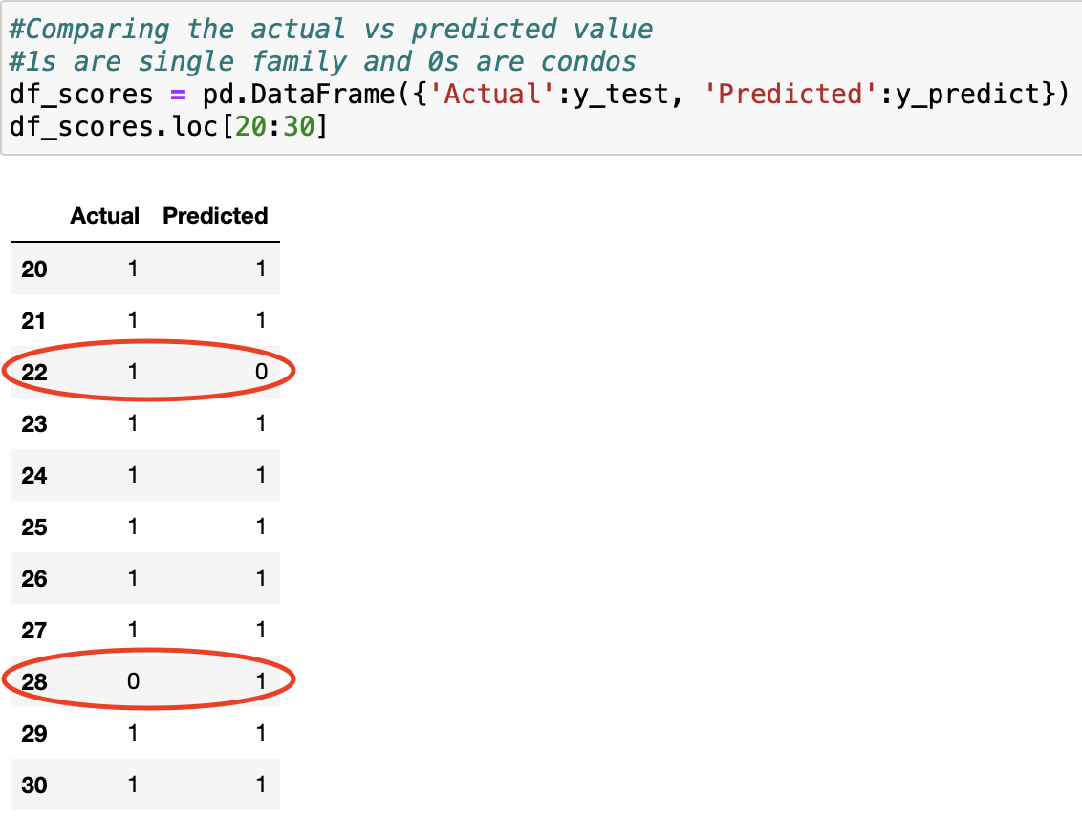
Prediction Graph
We have removed the outliers on the left side of the graph as you can see in the prediction graph.
We created a new data frame to compare the actual y with the predicted y. You can notice the predicted y has a high accuracy by looking at the data frame.

Slide 8
Prediction about an unknown
So, we chose random x-values(inputs), and provided those inputs to our model to predict. We got different predictions for different inputs which shows that our model is working as it should.
1 denotes Single Family
0 denotes Condo.

Slide 9
References:
M, R. (2022, July 12). How to classify data in python using Scikit-Learn. ActiveState. Retrieved from https://www.activestate.com/resources/quick-reads/how-to-classify-data-in-python/
Sklearn.preprocessing.LabelEncoder. scikit. (n.d.). Retrieved from https://scikit-learn.org/stable/modules/generated/sklearn.preprocessing.LabelEncoder.html

Slide 10
THANK YOU Any questions?

